Slide 1
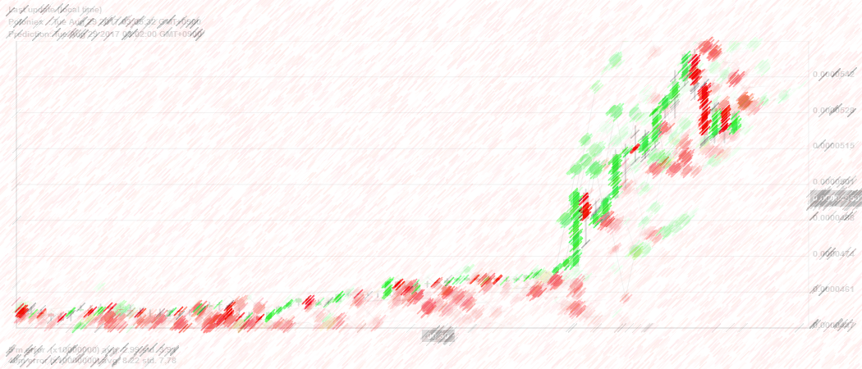
Using Deep Learning Neural Networks and Candlestick Chart Representation to Predict Stock Market
심층신경망을 이용하여 캔들차트로 표현한 주식시장 예측
팀 연어유희

Slide 2

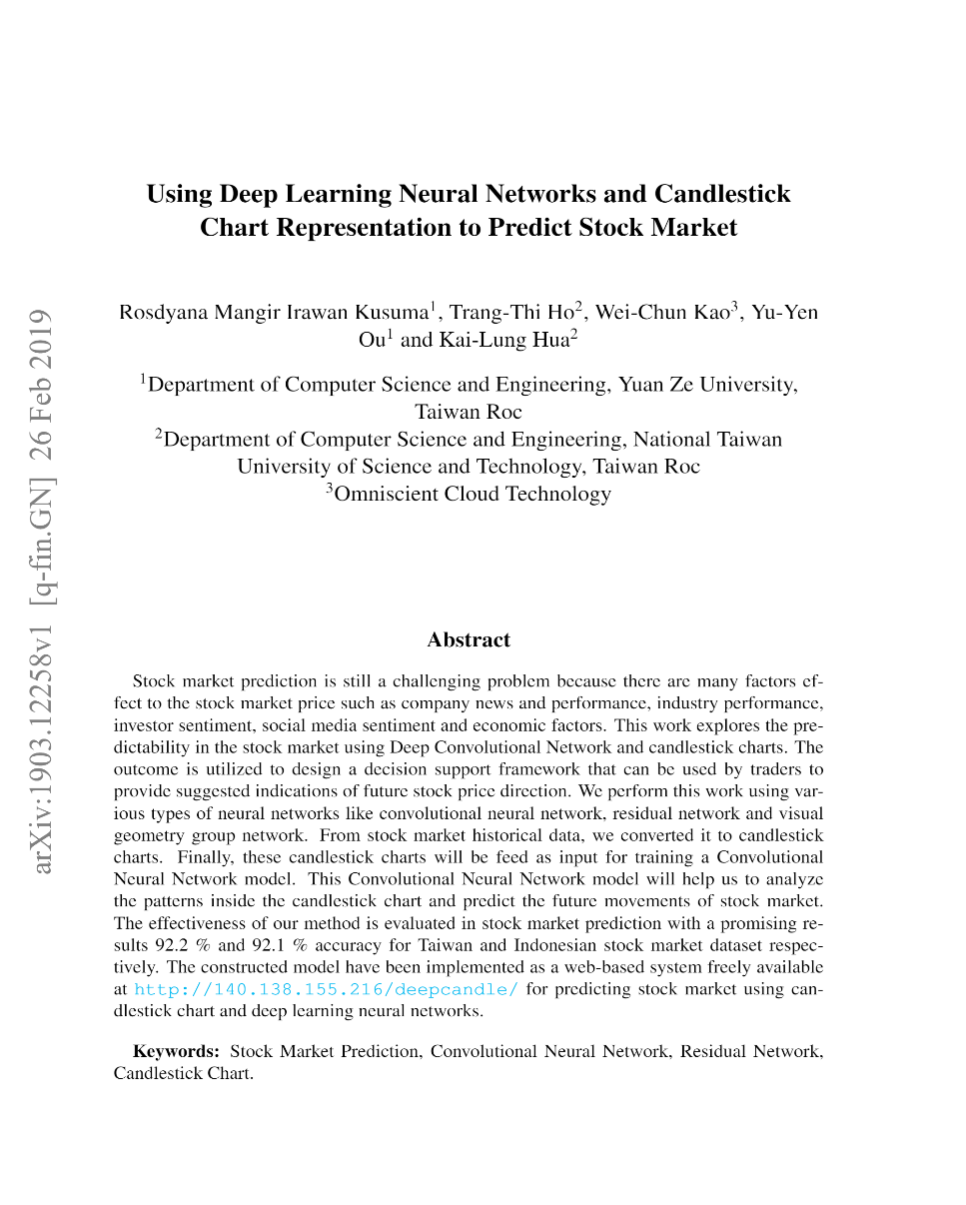
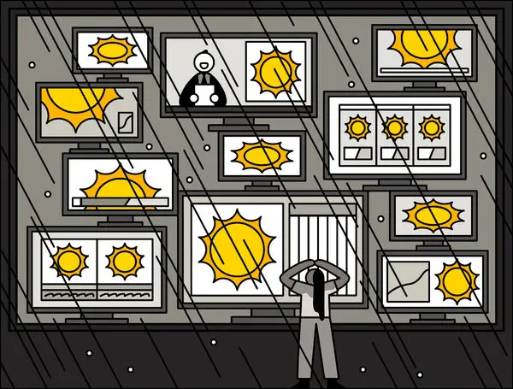
Abstract
의존하지 말아야 할 한 가지가 있다면,
그것은 바로 예측이다.
#StockMarket_Prediction #Convolutional_Neural_Network #Residual_Network #Candlestick_Chart

Slide 3
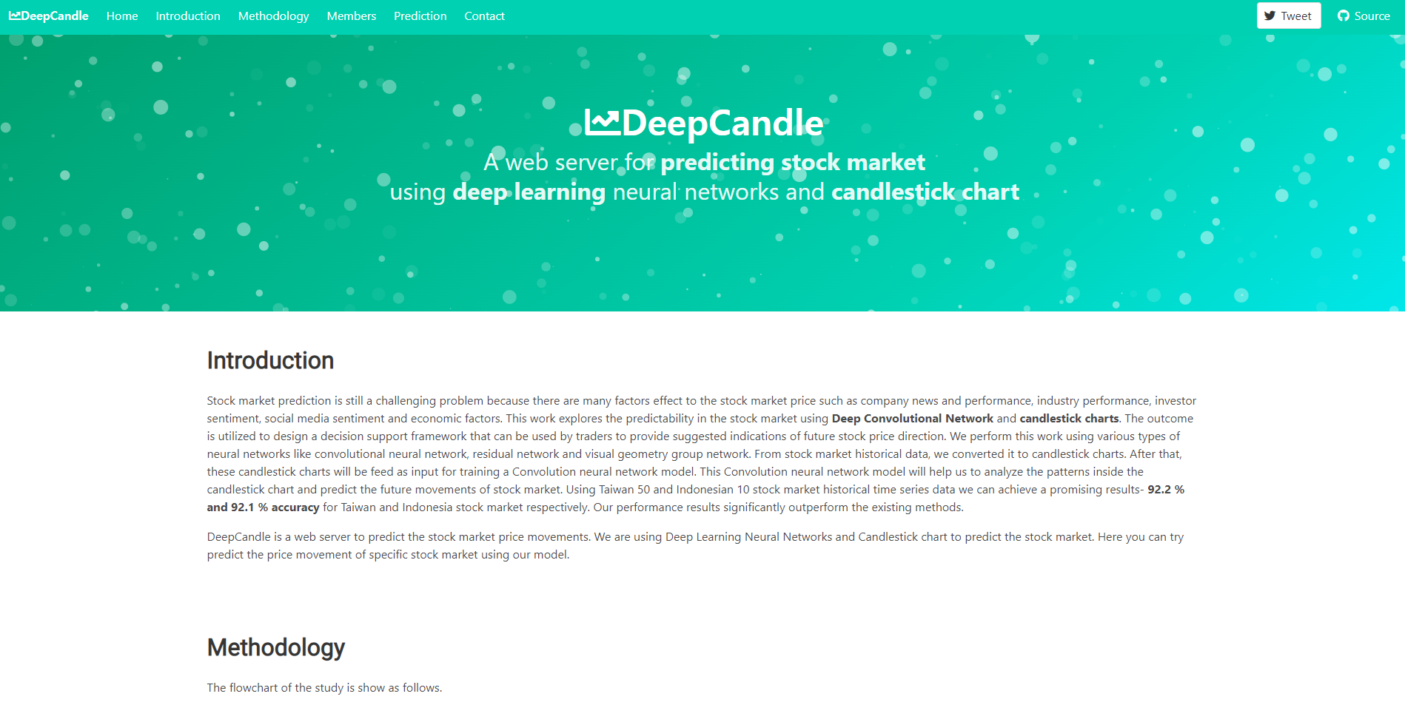
Abstract
http://140.138.155.216/deepcandle/

Slide 4
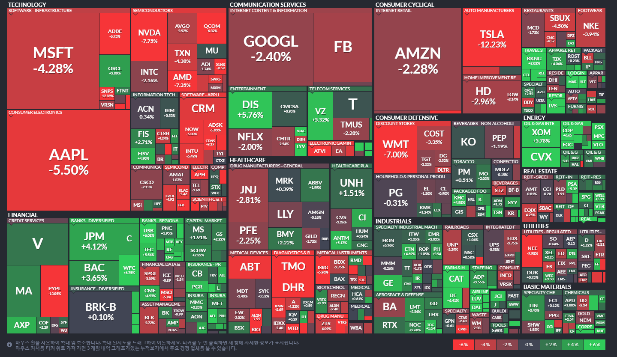
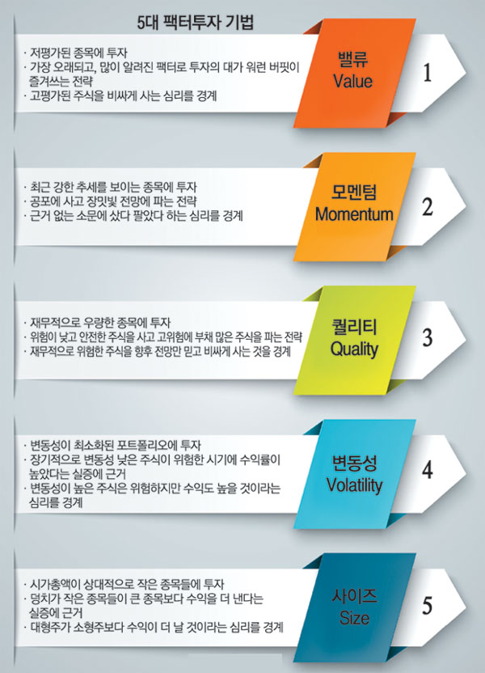
Stock Market Prediction

Slide 5
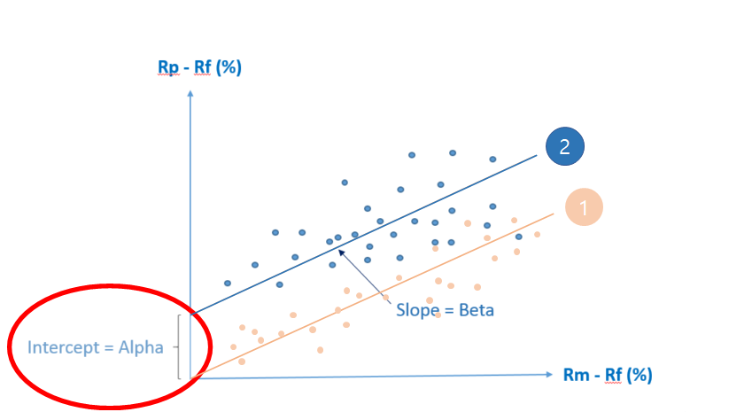
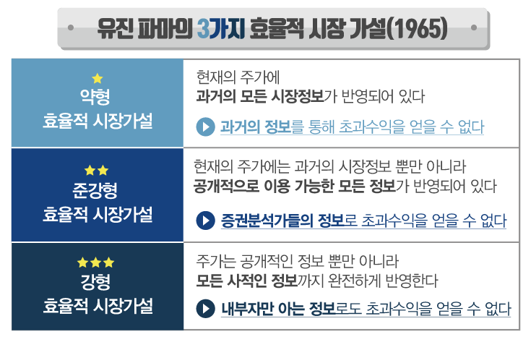

Introduction 1

Slide 6
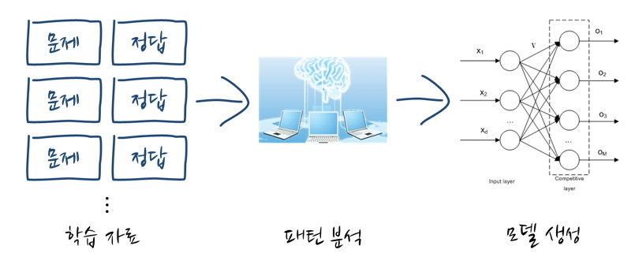
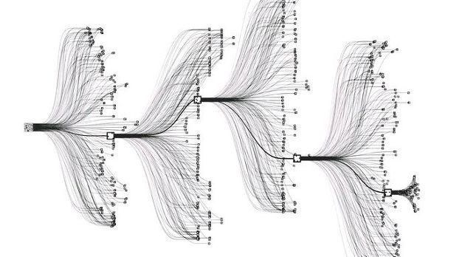
Introduction 2
On the other occasion, from historical data of stock market converted into audio wavelength using deep convolutional wave net architecture can be applied to forecast the stock market movement.

Slide 7
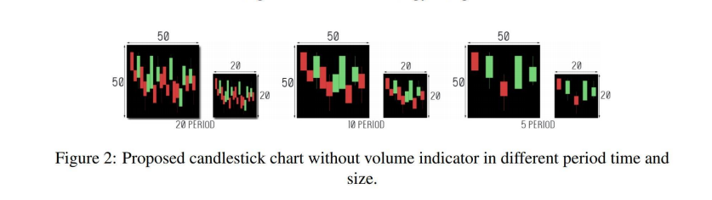


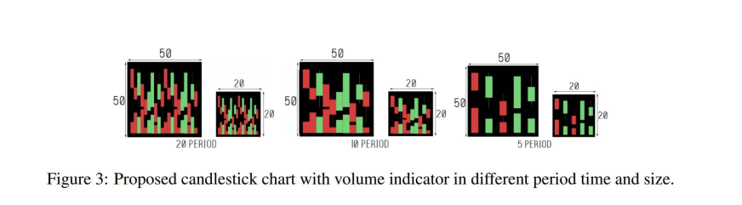
Introduction 3
The goal is to analyze the correlation of some parameters such as period time, image size, feature set with the movement of stock market to check whether it will be going up or going down in the next day.

Slide 8
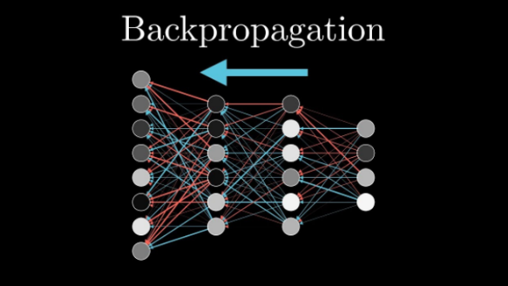



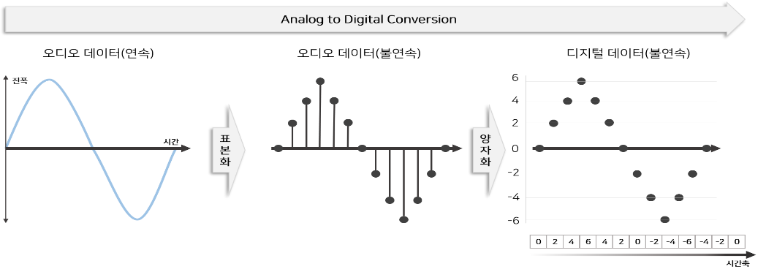
Related Work 1
 | In 1990, (Schneburg) conducted a study using data from a randomly selected German stock market, then using the back-propagation method for their machine learning architecture
 | (J. Bollen) reported the sentiment analysis method by taking data from one of the famous microblogging site Twitter to predict the Dow Jones Industrial Average (DJIA) stock market movements
 | (Borovykh, Bohte et al.) tried to use the deep convolutional wave net architecture method to perform analysis and prediction using data from S&P500 and CBOE

Slide 9
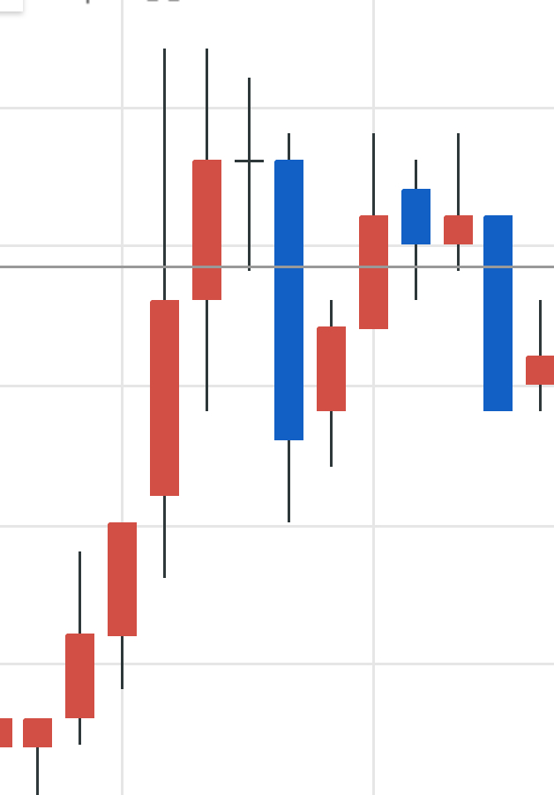
Related Work 2
Related works using candlestick charts in their research
(Zhang, Zhang et al. 2018) input data is not only from historical stock trading data, a financial news and users sentiments from social media can be correlated to predict the movement in stock market.
(do Prado, Femeda et al. 2013) used the candlestick chart to learn the pattern contained in Brazilian stock market by using sixteen candlestick patterns.
(Tsai and Quan 2014) utilized the candlestick chart to combine with seven different wavelet-based textures to analyze the candlestick chart.
(Hu, Hu et al. 2017) used the candlestick chart to build a decision-making system in stock market investment. They used the convolutional encoder to learn the patterns contained in the candlestick chart.
(Patel, Shah et al. 2015) used ten technical parameters from stock trading data for their input data and compare four prediction models, Artificial Neural Network (ANN), Support Vector Machine (SVM), random forest and nave-Bayes.
(Khaidem, Saha et al. 2016) combine the Random Forest with technical indicator such as Relative Strength Index (RSI) shown a good performance.

Slide 10


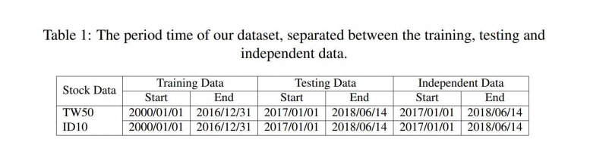
Dataset - Data Collection

Slide 11
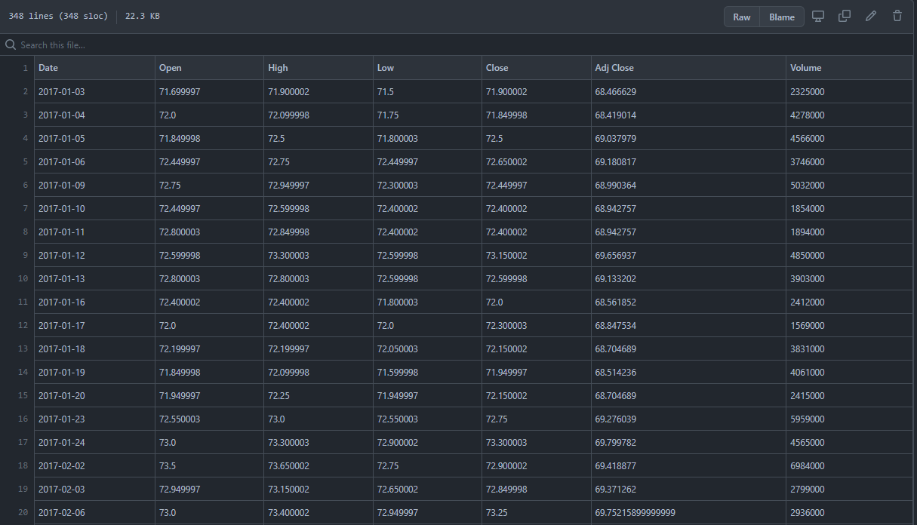


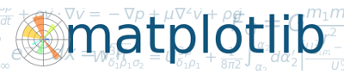
Dataset - Data Preprocessing

Slide 12
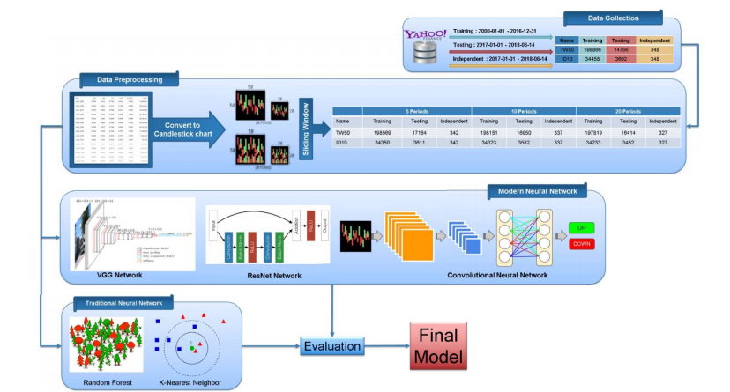
Methodology

Slide 13
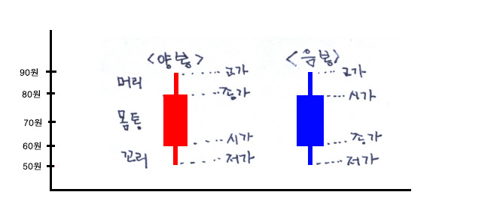
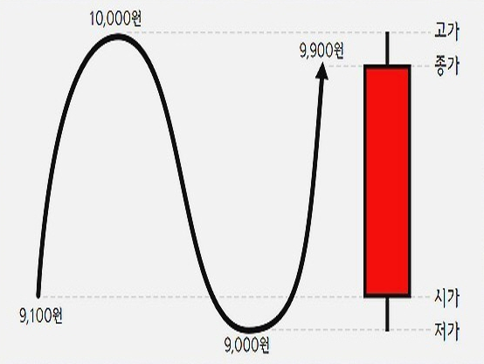

Methodology - Candlestick Chart
Notes:
Candlestick chart is a style of financial chart used to describe the price movements for a given period of time. Candlestick chart is named a Japanese candlestick chart which has been developed by Japanese rice trader - Munehisa Hooma. Each candlestick typically shows one day of trading data, thus a month chart may show the 20 trading days as 20 candlestick charts. Candlestick chart is like a combination of line-chart and a bar-chart. While each bar represents four important components of information for trading day such as the open, the close, the low and high price. Candlesticks usually are composed of 3 components, such as upper shadow, lower shadow and real body. If the opening price is higher than the closing price, then the real body will filled in red color. Otherwise, the real body will be filler in green color. The upper and a lower shadow represent the high and low price ranges within a specified time period. However, not all candlesticks have a shadow. Candlestick chart is a visual assistance to make a decision in stock exchange. Based on candlestick chart, a trader will be easier to understand the relationship between the high and low as well the open and close. Therefore, the trader can identify the trends of stock market for a specific time frame [8]. The candlestick is called bullish candlestick when the close is greater than the open. Otherwise it is called bearish candlestick. Figure 2 and Figure 3 describe our candlestick chart representation in different period time and size with volume and without volume respectively.

Slide 14
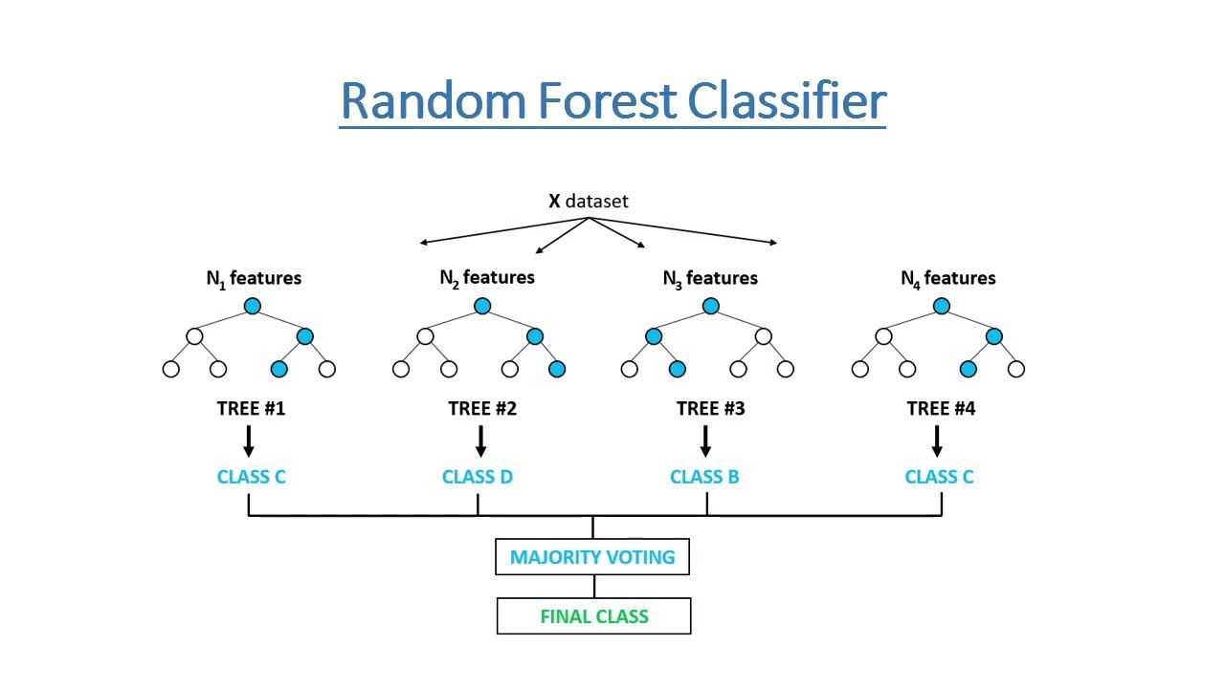
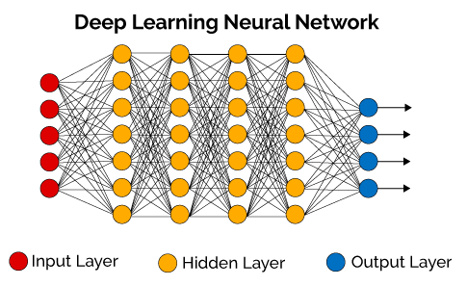
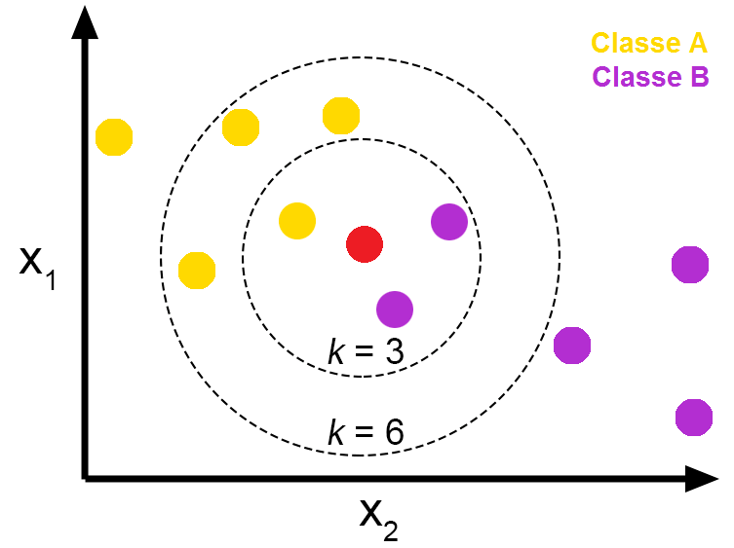
Methodology - Learning Algorithm
Notes:
In this work we will use some Deep Learning Networks (DLN) based on Convolutional Neural Network to perform our classification on stock market prediction. Besides the DLN, we also apply some traditional Machine Learning (ML) algorithms to compare with DLN. Those traditional Machine Learning algorithms are and K-Nearest Neighbors algorithms.

Slide 15
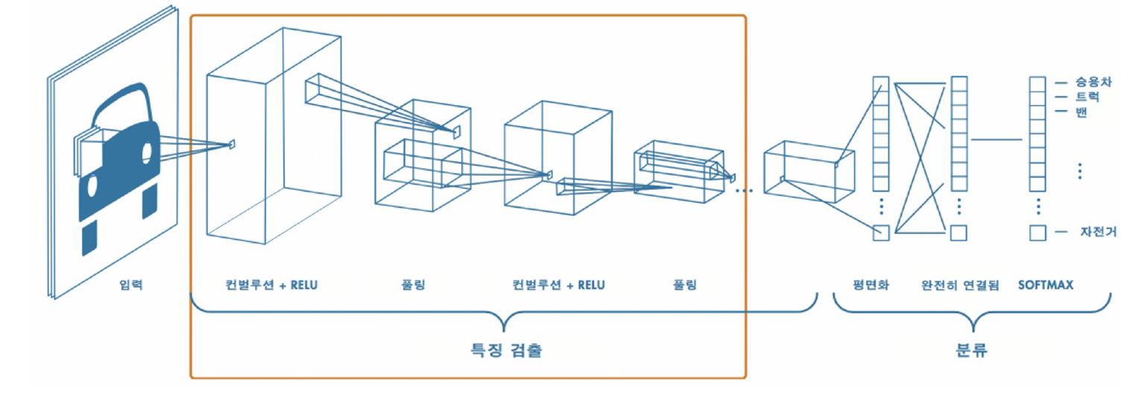
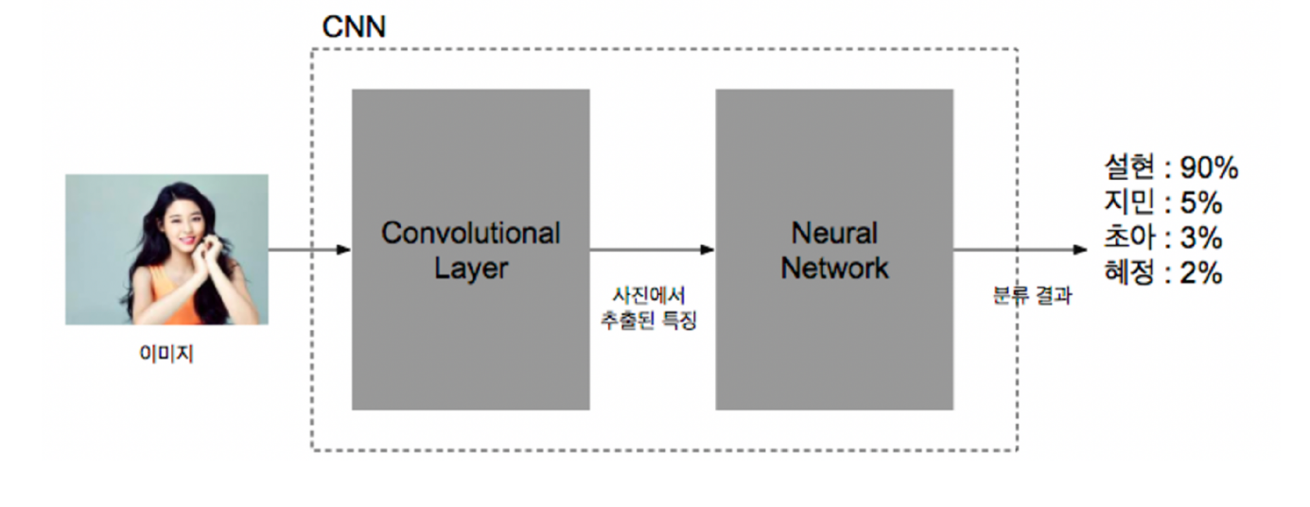

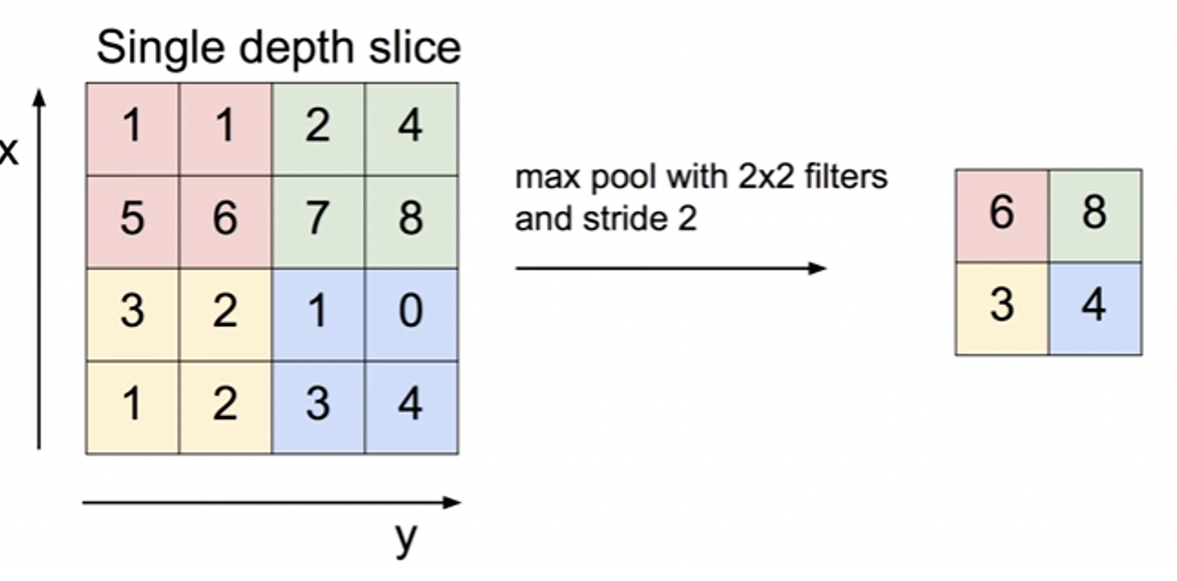
Methodology - Convolutional Neural Network 1

Slide 16
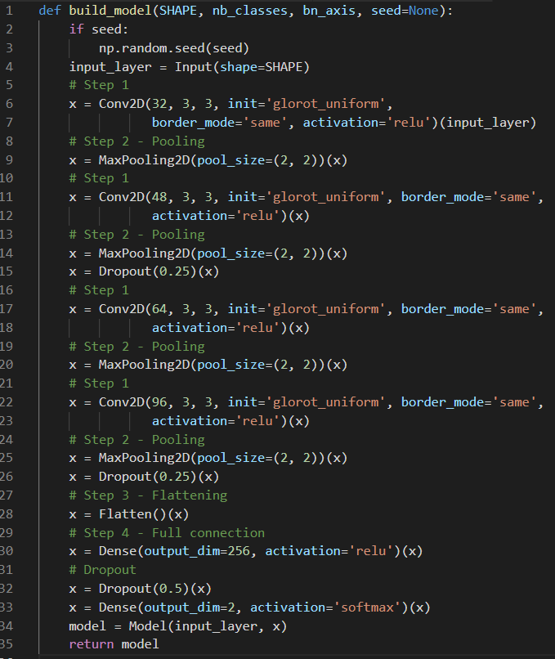
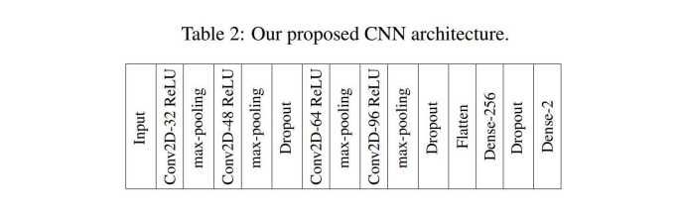
Methodology - Convolutional Neural Network 2

Slide 17
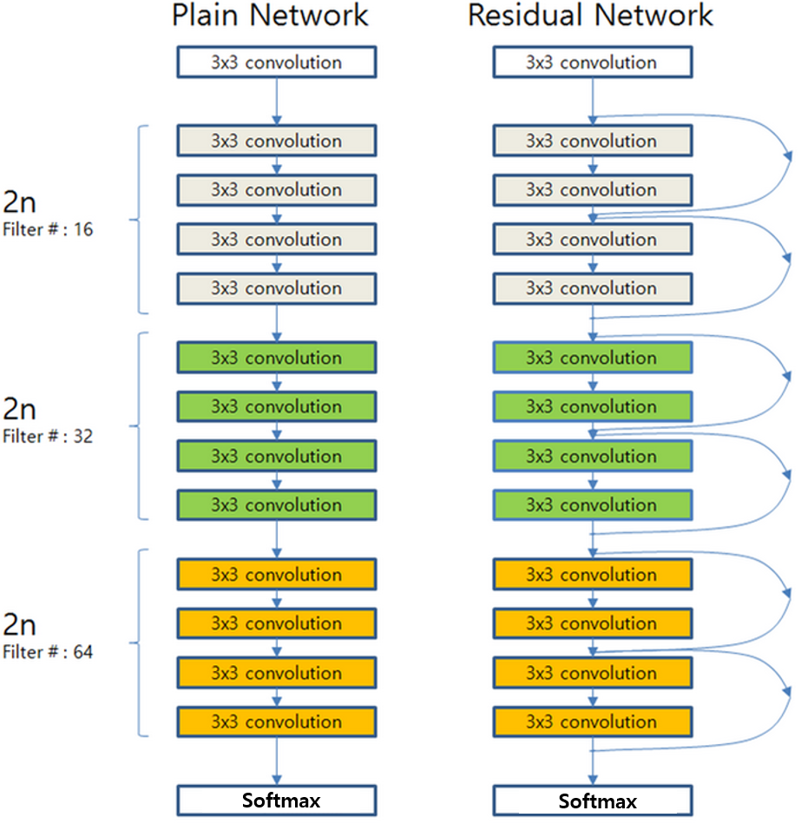
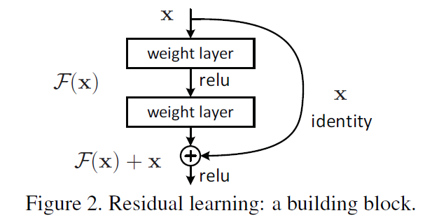
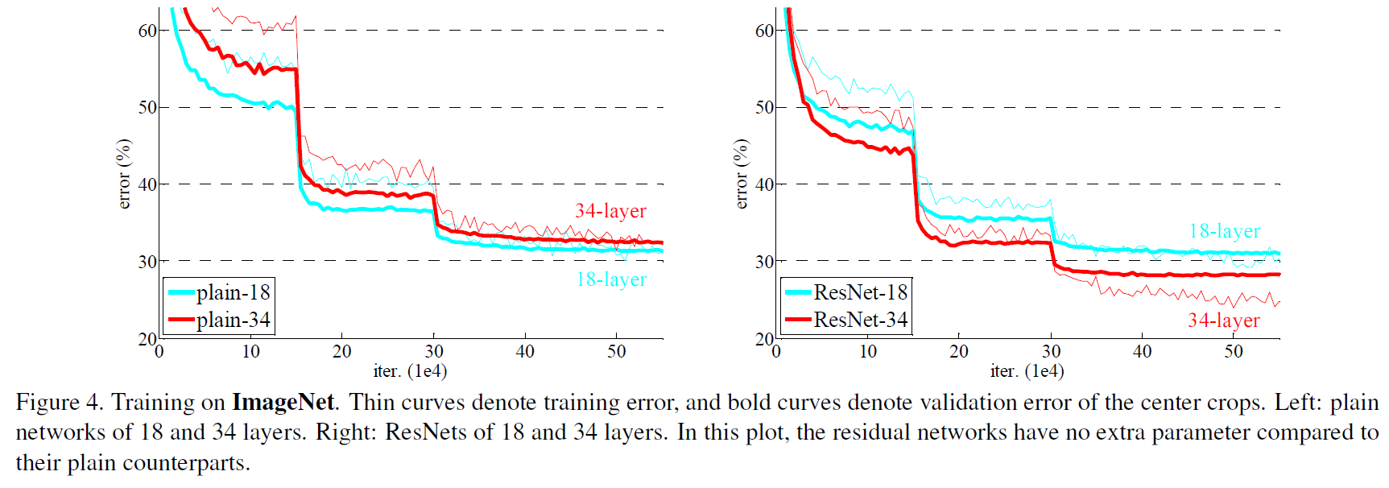
Methodology - Residual Network
Notes:
It is an artificial neural network developed by He in 2015 [4]. It uses skip connections or short­ cut to jump over some layers. The key of residual network architecture is the residual block, which allows information to be passed directly through. Therefore, the backpropagated error signals is reduced or removed. This allows to train a deeper network with hundreds of layers. And this vastly increased depth led to significant performance achives.

Slide 18
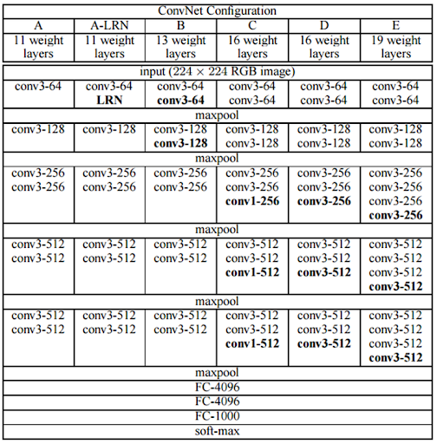

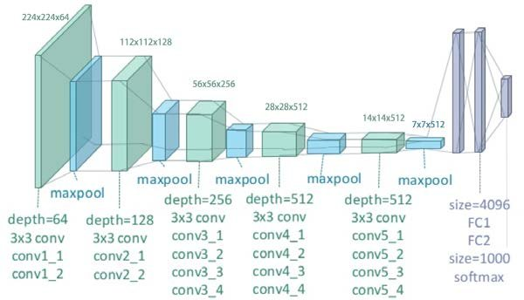
Methodology - VGG Network
Notes:
The VGG network architecture was introduced by Simonyan and Zisserman[14]. It is named VGG because this architecture is from VGG group, Oxford. This network is characterized by its simplicity, using only 3x3 convolutional layers stacked on top of each other in increasing depth. Reducing volume size is handled by max pooling. Two fully connected layers, each with 4096 nodes are then followed by a softmax classifier. The 16 and 19 stand for the number of weight layers in the network. Unfortunately, there are two major drawbacks with VGGNet. First, it is painfully slow to train and the second the network architecture weights themselves are quite large.

Slide 19
Methodology – Random Forest
월등히 높은 정확성
간편하고 빠른 학습 및 테스트
변수 소거 없이 수천 개의 입력 변수가능
임의화를 통한 좋은 일반화 성능
다중 클래스 알고리즘 특성
Bagging 방지
Notes:
Random Forest classifier is a classifier with consist of many decision trees and adopted the technique of random decision forest prioritizes predictive performance by using multiple learning algorithms (ensemble learning). In general, Decision trees are a learning methods used in data search technique. The method used by the idea of combining the ’’bagging” idea or called ’’Bootstrap Aggregating99 (reduce variance) and the random selection of features in the training sets (classification and regression tree).
The difference between Random Forest algorithm and the decision tree algorithm is that in Random Forest, the processes of finding the root node and splitting the feature nodes will run randomly. We applied our random forest algorithm from a machine learning python library called skicit-learn[12].

Slide 20
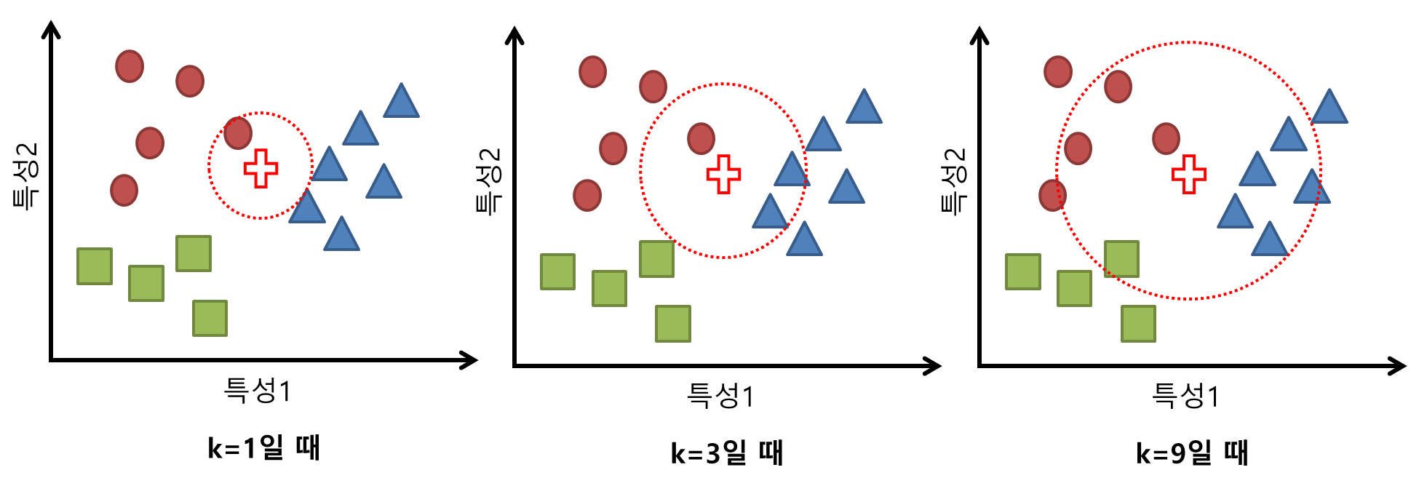
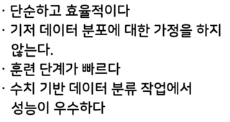
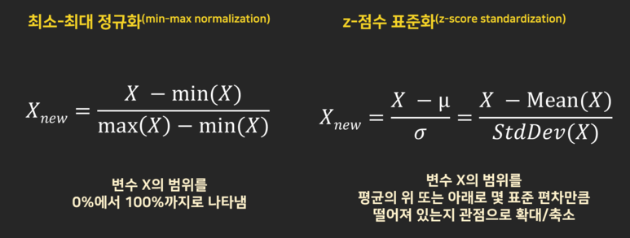
Methodology – K-Nearest Neighbors

Slide 21
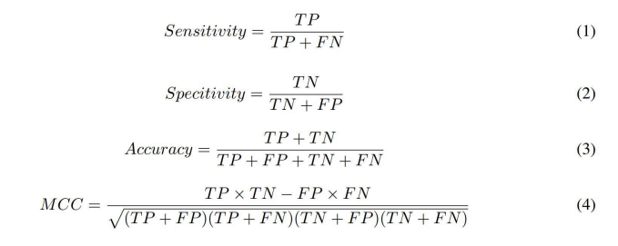
Methodology – Performance Evaluation
민감도(Recall): 진짜를 진짜로 예측될 확률
정밀도(precision): 예측값이 얼마나 맞았는지 확률
정확도 (accuracy):
예측값과와 실제값이 맞은 건수 / 전체 데이터 수
Matthew 상관 계수 (MCC):
phi coefficient라고도 불리는데, 옳고 그름을 판별하는 이진분류(binary classification)에 사용되는 metric이다.
-1과 1 사이의 값
1에 가까울수록 두 관측치가 비슷하다고 본다.
Notes:
There are some statistics measures of the performance evaluation to evaluate the result of all the classifiers by measuring the sensitivity (true positive rate or recall), specificity (true negative rate), accuracy and Matthew’s correlation coefficient (MCC). In general, TP is true positive or correctly identified, FP is false positive or incorrectly identified, TN is true negative or correctly rejected and FN is false negative or incorrectly rejected. Formulated as follows:

Slide 22
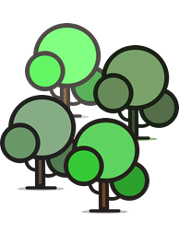
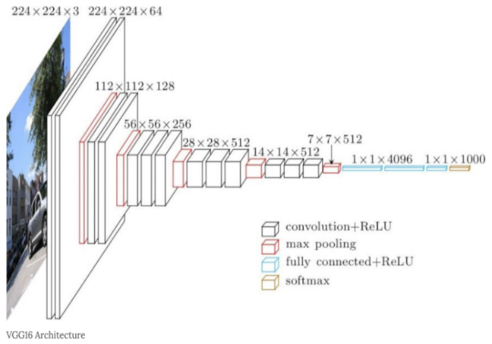

Experimental Results and Discussion
In this section, we perform classification based on some traditional and modem machine learning algorithms (random forest, kNN, residual network, VGG, CNN) and then evaluate the performance of our best classification algorithm compared to three state-of-the-art methods.

Slide 23
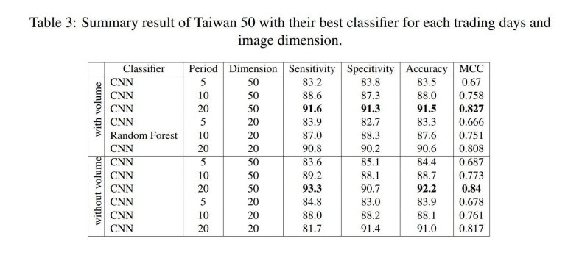
Classification for Taiwan 50 Dataset

Slide 24
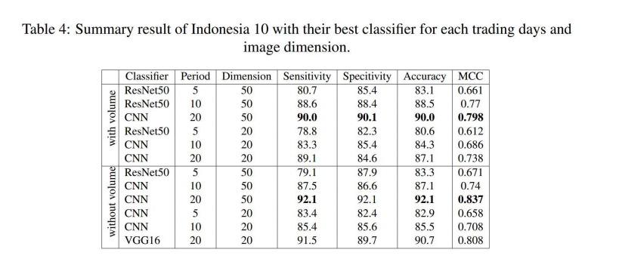
Classification for Indonesia 10 Dataset

Slide 25
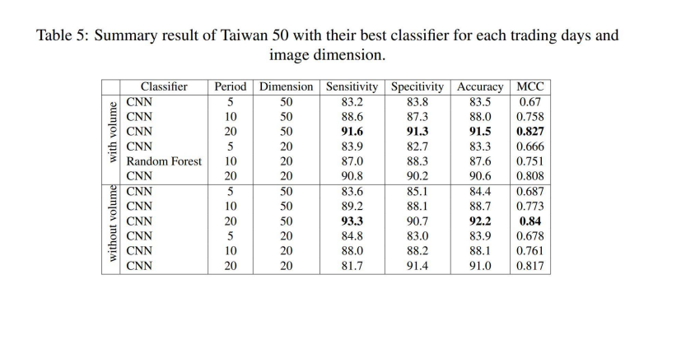
Independent Testing Result

Slide 26
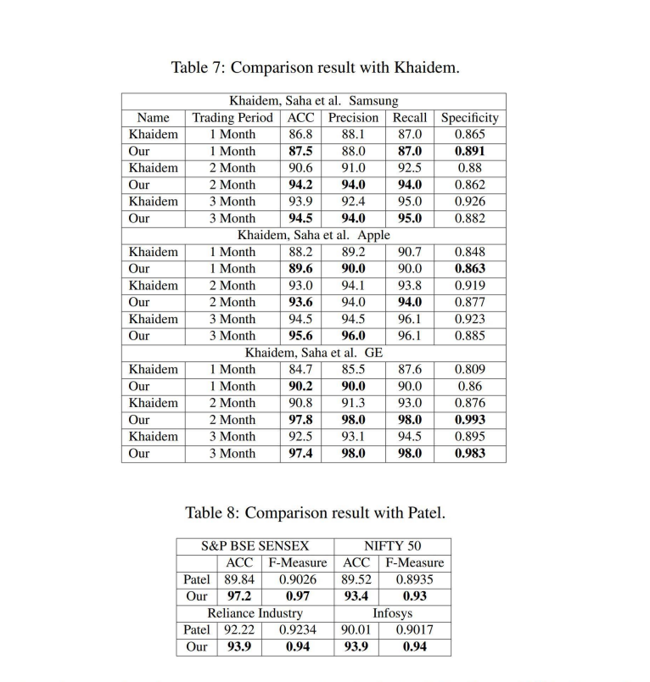
Comparison 1
(Khaidem, Saha et al. 2016) combine the Random Forest with technical indicator such as Relative Strength Index (RSI)

Slide 27
Comparison 2
(Patel, Shah et al. 2015) used ten technical parameters from stock trading data for their input data and compare four prediction models, Artificial Neural Network (ANN), Support Vector Machine (SVM), random forest and nave-Bayes.
F1 score = 2 * (Precision * Recall) / (Precision + Recall)

Slide 28
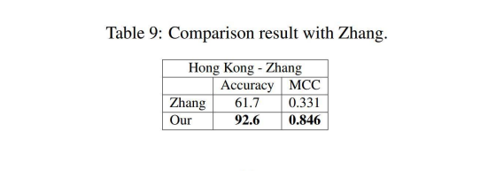
Comparison 3
(Zhang, Zhang et al. 2018) input data is not only from historical stock trading data, a financial news and users sentiments from social media can be correlated to predict the movement in stock market.

Slide 29
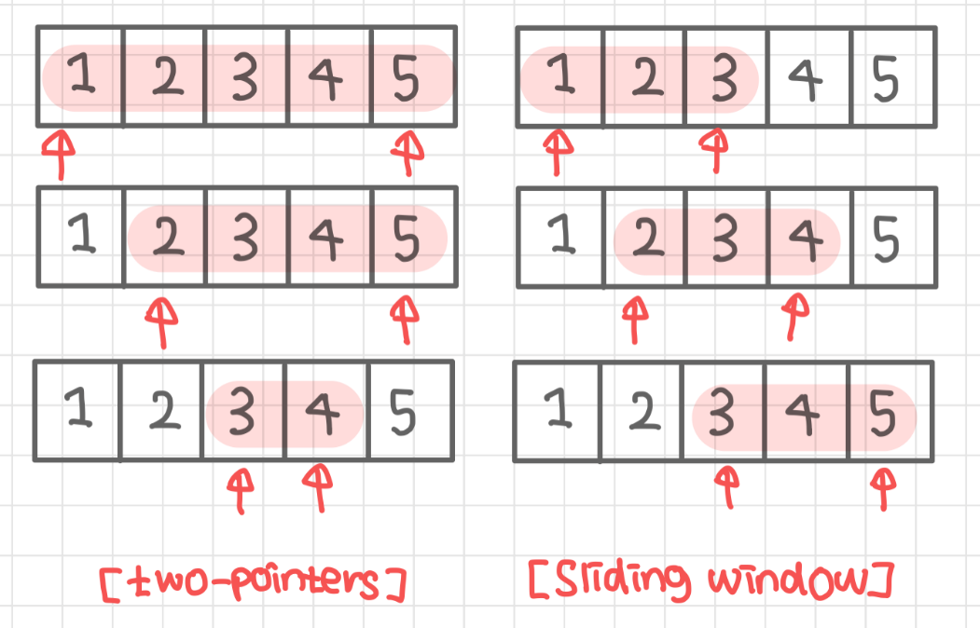
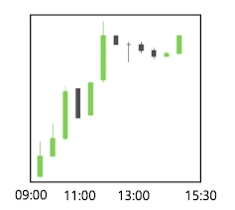
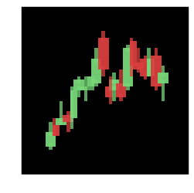
Conclusions and Future Works 1
In this study, we present a new method for stock market prediction using 2 stock market datasets including 50 company stock markets for Taiwan50 datasets and 10 company stock market for Indonesian datasets. The first, we employ the sliding window technique to generate the period data. To find out correlation between enrich candlestick chart information and stock market prediction performance, we utilized the computer graphic technique to generate the candlestick chart images for stock market data. Finally, an CNN learning algorithm is employed to build our prediction for stock market.

Slide 30
Conclusions and Future Works 2
We found that the model using long-term trading days period with CNN learning algorithm achieves the highest performance of sensitivity, specificity, accuracy, and MCC. It is proved that Convolutional neural network can find the hidden pattern inside the candlestick chart images to forecast the movement of specific stock market in the future. Adding the indicator such as volume in candlestick chart not really help the algorithms increase finding the hidden pattern.

Slide 31
Conclusions and Future Works 3
The comparison experiments indicated that our proposed method provide highly accurate forecast for other datasets compare to the other existing methods. Patel used trading data from Reliance Industries, Infosys Ltd., CNX Nifty and S&P Bombay Stock Exchange BSE Sensex during 10 years with accuracy in the range of 89% - 92% while we achieved accuracy in the range of 93% - 97%. Khaidem method achieved the accuracy in the range of 86% - 94% using three trading data from Samsung, GE and Apple while we achieved in the range of 87% - 97%. Zhang utilized 13 different companies in Hong Kong stock exchange with accuracy 61%. Meanwhile, our method achieved 92% for accuracy.

Slide 32
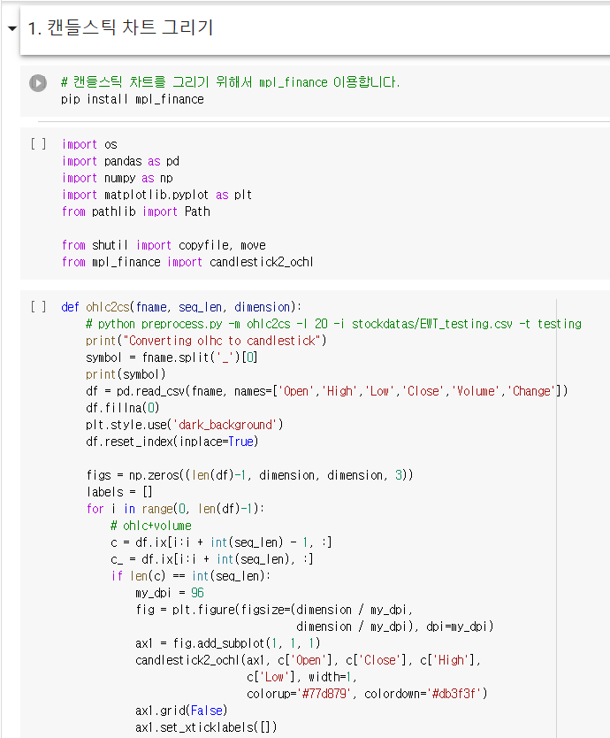
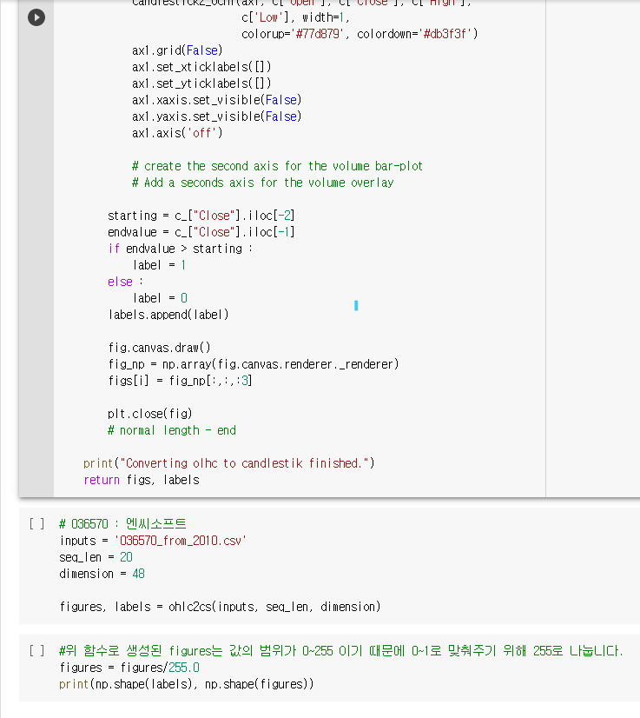
Model Implementation

Slide 33


Model Implementation

Slide 34


Model Implementation

Slide 35


Model Implementation

Slide 36

Conclusions
1 | 2 | 3 | 4 | 5 | 정확도
하나 | 둘 | 셋 | 넷 |  | ?
One | Two | Three | Four |  | ?
i | ii | iii | iv |  | ?

Slide 37

팀 연어유희

